Slide 1
Data Visualization Presentation
By: Hesam Sadri
May 2021

Slide 2
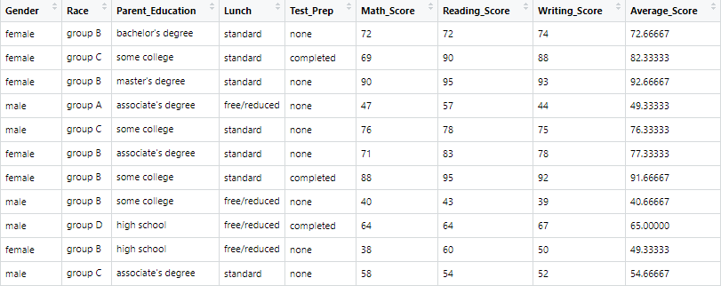
In this visualization project, I used the dataset of student's performance on the exam. You can find the data here:
https://www.kaggle.com/spscientist/students-performance-in-exams
The dataset has 1000 samples(students) and it has 8 variables, which are:
Gender, Race, Parents Education Levels, Prep_Course, Math Score, Writing Score, Reading Score.
I also add the average score to this dataset which is the average score of all three scores.
My Goal is to find some informative relation between these variables and use what I learned in this course to visualize these relationships in the best possible way.

Slide 3
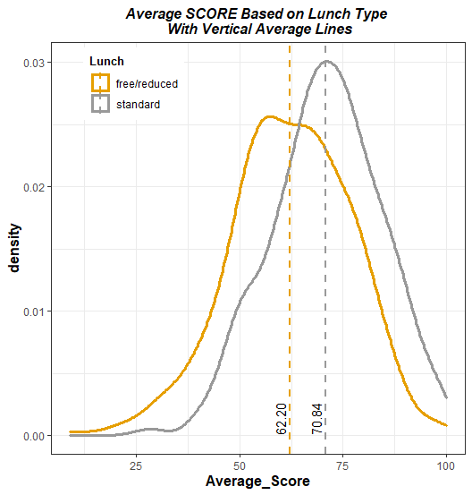
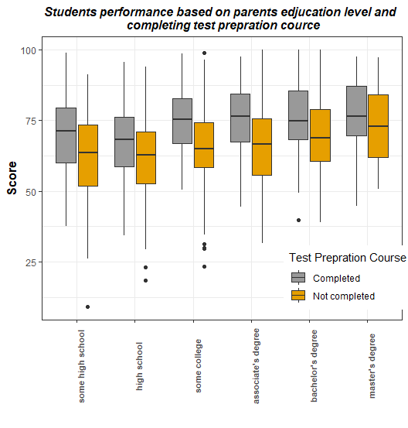
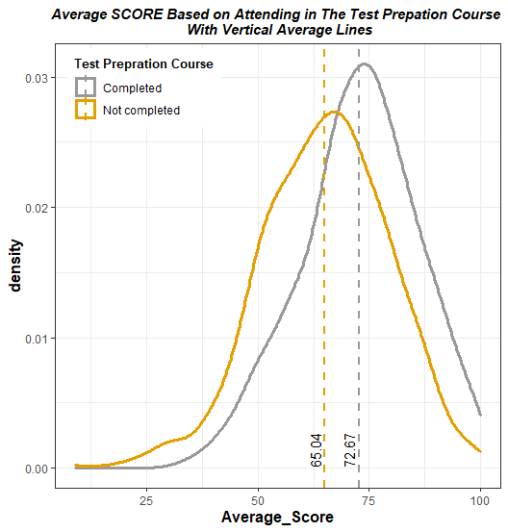
Economic Status

Slide 4
